Slide 1

Team 2 – Caleb Rush, Jordan LaRiccia, Adam Meanor

Slide 2
Description
A turn based strategy game where players can create their own character called an “Amalgamation” and do battle.

Slide 3
Terminology

Slide 4
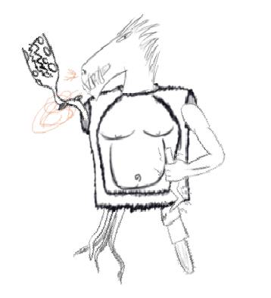
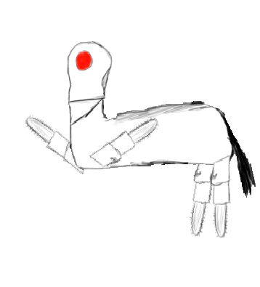
Amalgamations
The playable characters in the game. Visually, a combination of different body parts.

Slide 5
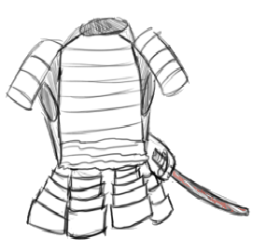
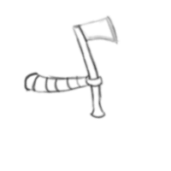
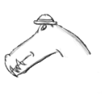
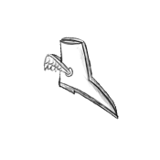
Parts
The body parts that make up an Amalgamation. The Parts an Amalgamation is made up of determines how strong it is and what it can do in battle.

Slide 6
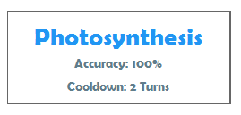
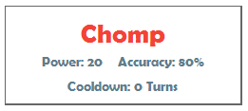
Abilities
The actions that can be performed by Amalgamations in battle. They may be an attack that will hurt another Amalgamation, or it may be a technique that increases the Amalgamation’s strength.

Slide 7
Scope

Slide 9
Structure

Slide 13
Behavior

Slide 16
Implementation Progress

Slide 17
What is Completed:
Every class is implemented
All features work
User Interface is fully designed

Slide 18
What Needs Done:
Resources need to be completed (specific Parts, Abilities, etc.)
Minor bugs/issues need to be fixed

